Slide 1

CSE 460: VLSI Design
Lecture 13+14: VLSI Physical Design

Slide 2
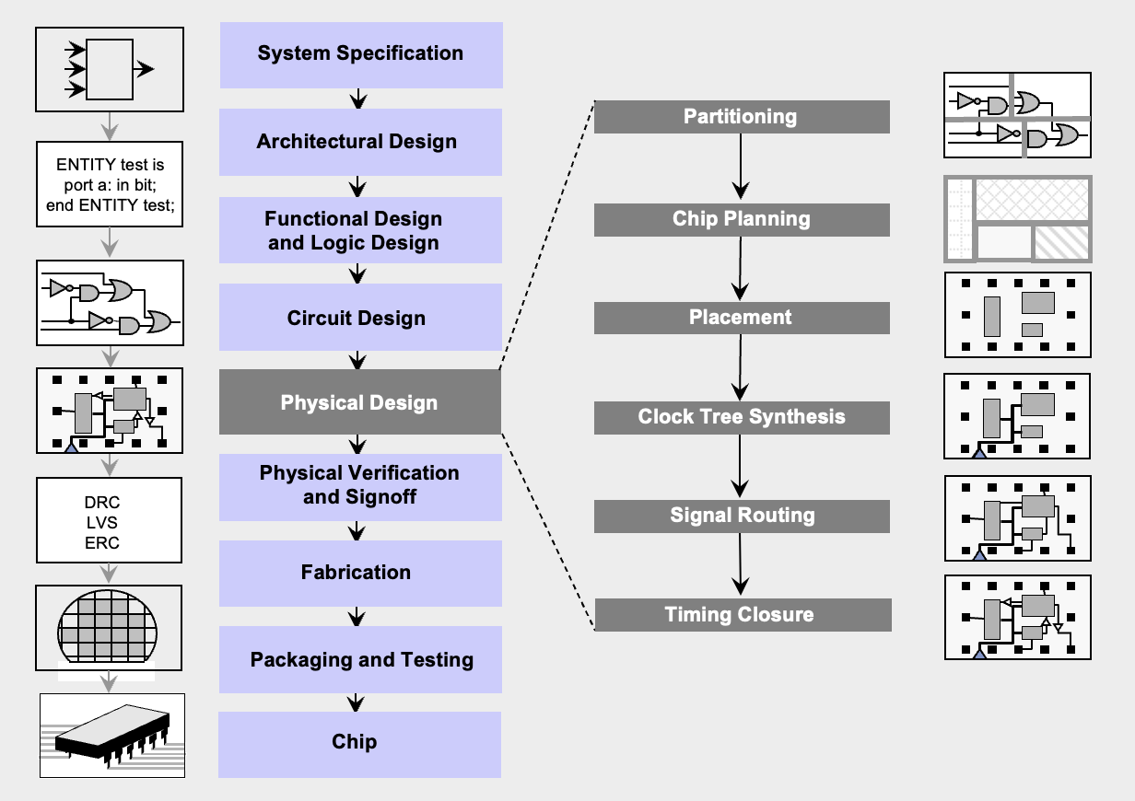
VLSI Design Flow

Slide 3
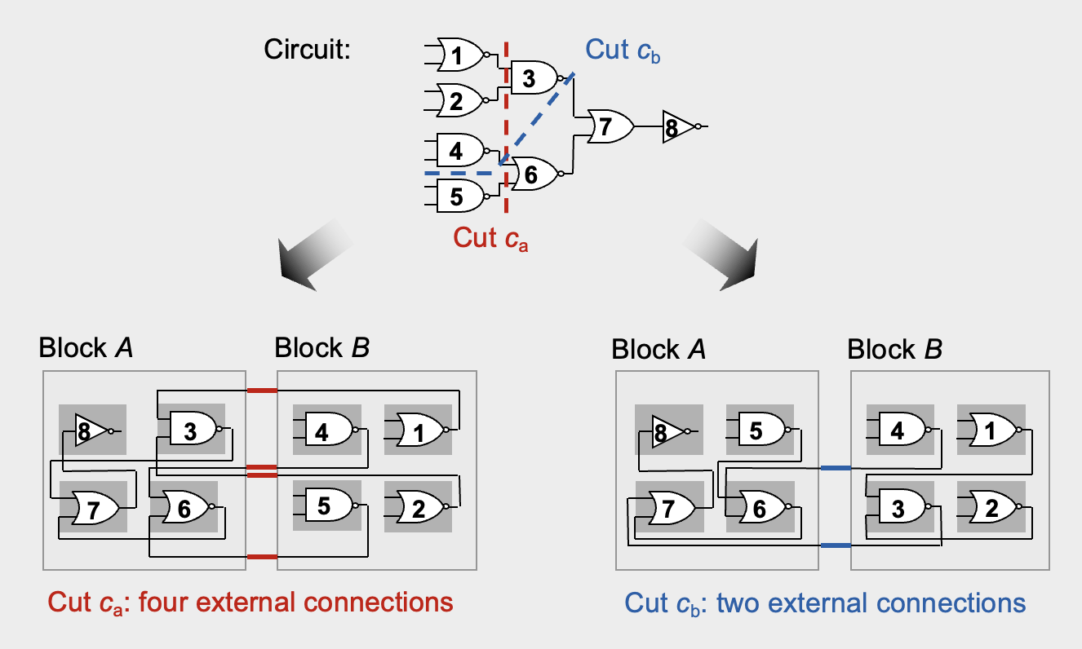
Partitioning
Algorithms Involved: Kernighan-Lin (KL) Algorithm, Fiduccia-Mattheyses (FM) Algorithm

Slide 4
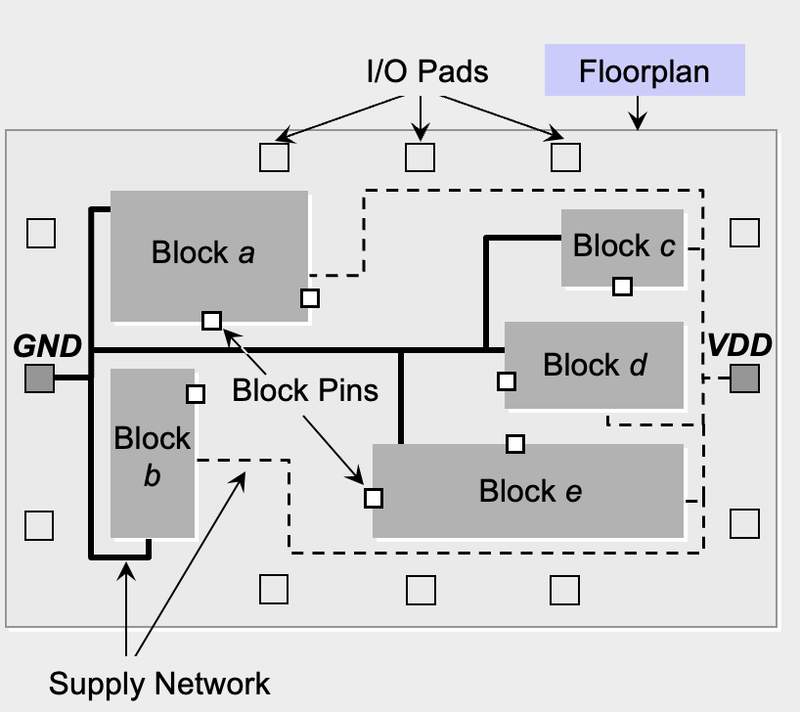
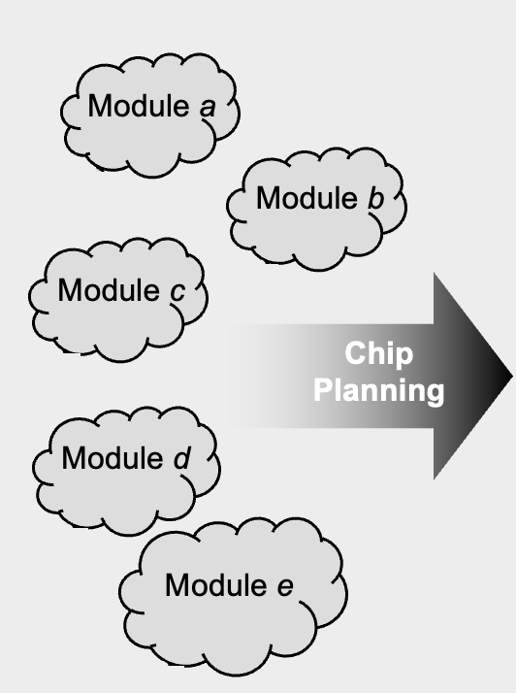
Chip Planning

Slide 5
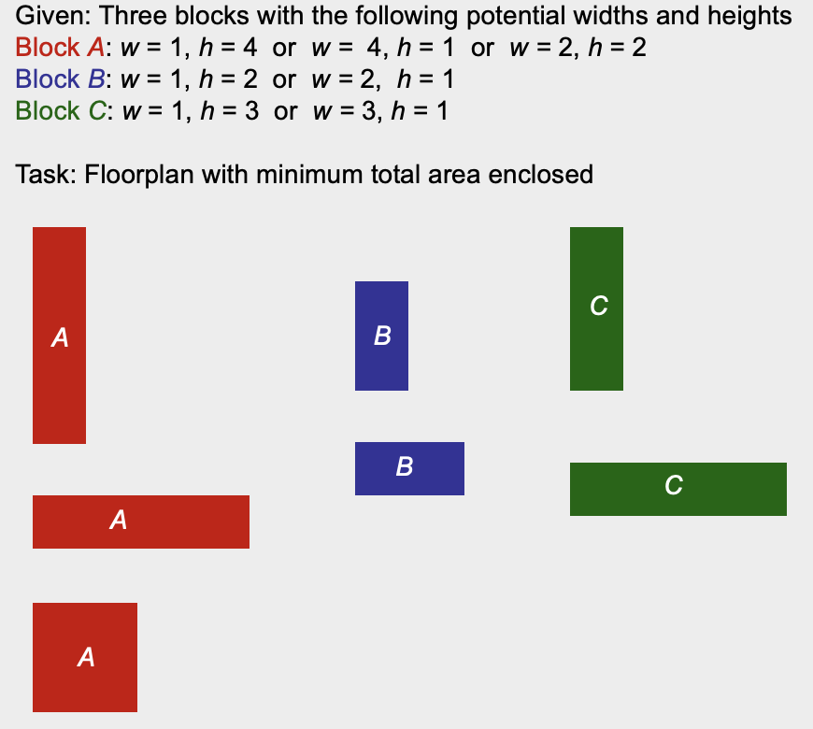
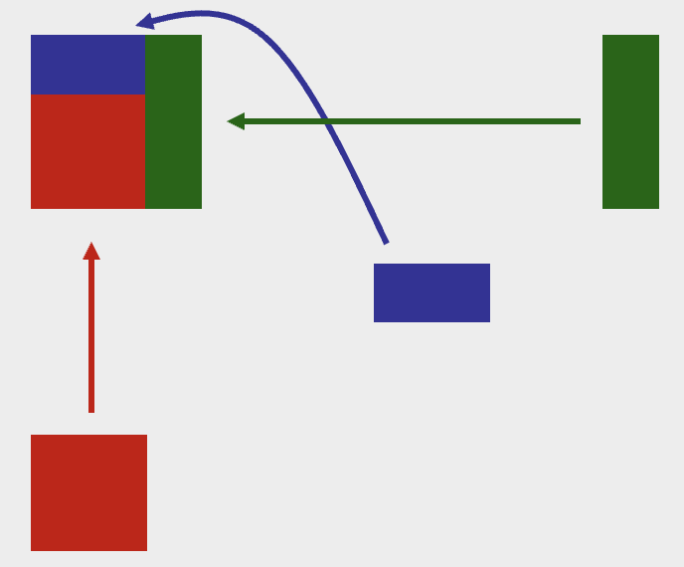
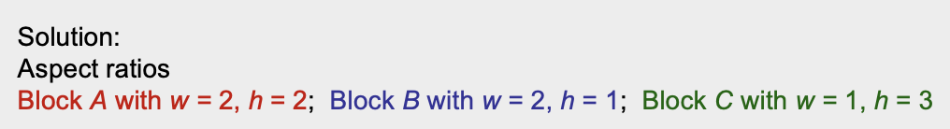
Chip Planning (Example)

Slide 6
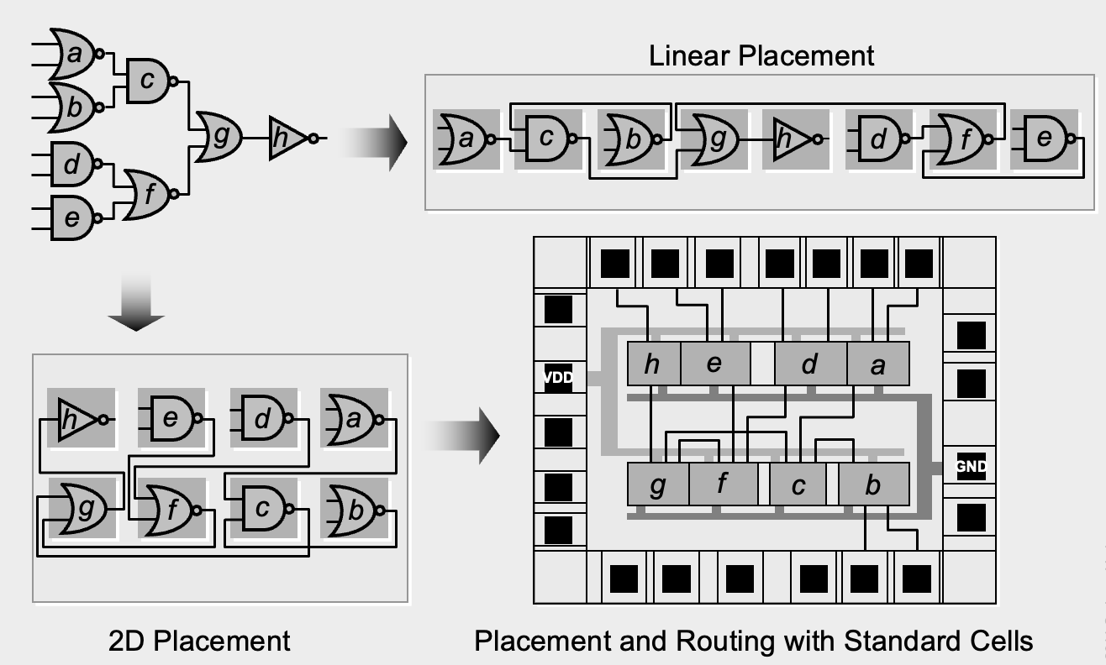
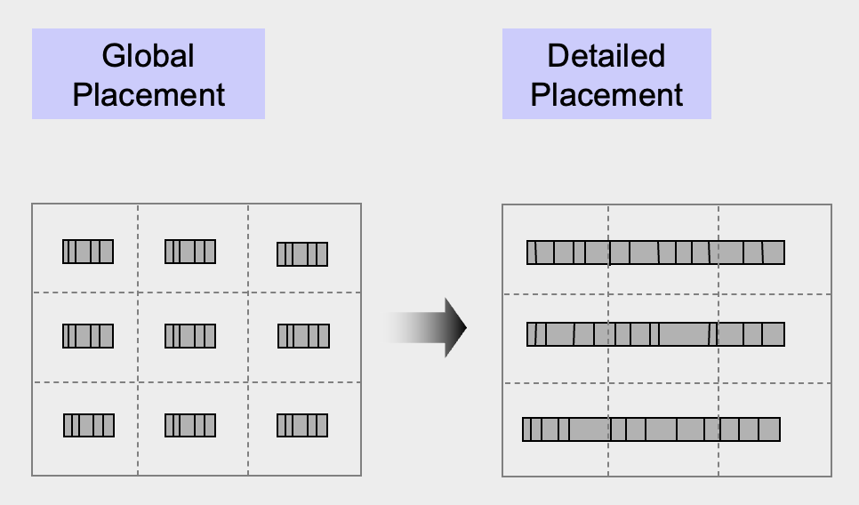
Placement

Slide 7
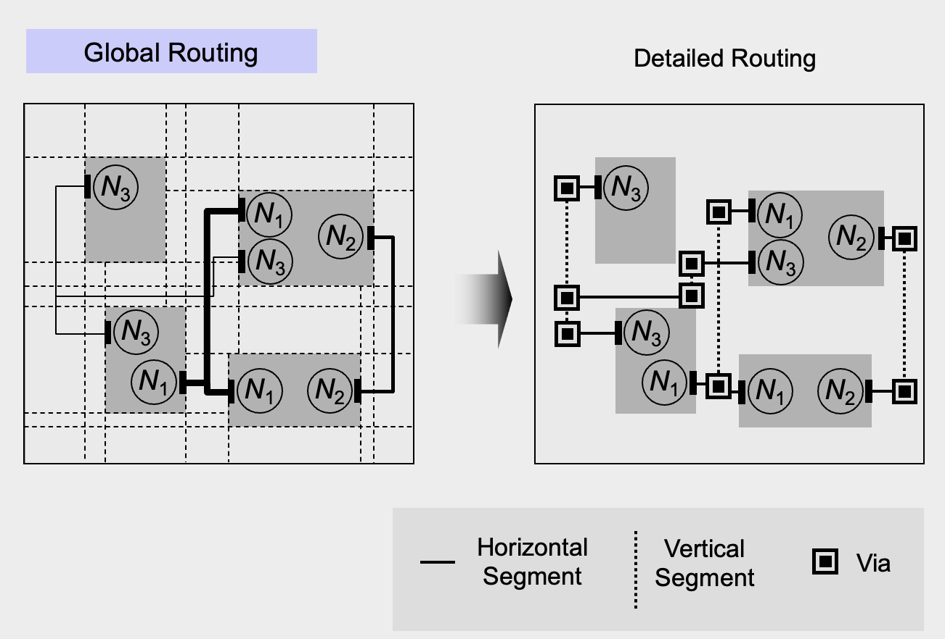
Signal Routing

Slide 8
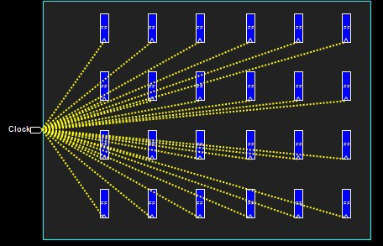
Clock Tree Synthesis (CTS)
Definition:
Clock tree synthesis is a process which make sure that the clock gets distributed evenly to all sequential elements in a design.
CTS is the process of insertion of buffers or inverters along the clock paths of ASIC design in order to achieve minimum skew or balanced skew.
In ICs, clock consumes around half of the total power consumption. Here clock gating technique helps to reduce power consumption by the clocks.
Goals of CTS:
To meet clock tree design rule constraints such as maximum transition, maximum load capacitance and maximum fanout.
To meet clock tree targets such as minimum skew and minimum insertion delay.

Slide 9
Timing Closure
Timing closure is the process by which a logic design consisting of primitive elements such as combinatorial logic gates ( and , or , not , nand , nor , etc.) and sequential logic gates (flip flops, latches, memories) is modified to meet its timing requirements.
Timing closure is done through layout optimizations and netlist modifications.

Slide 10
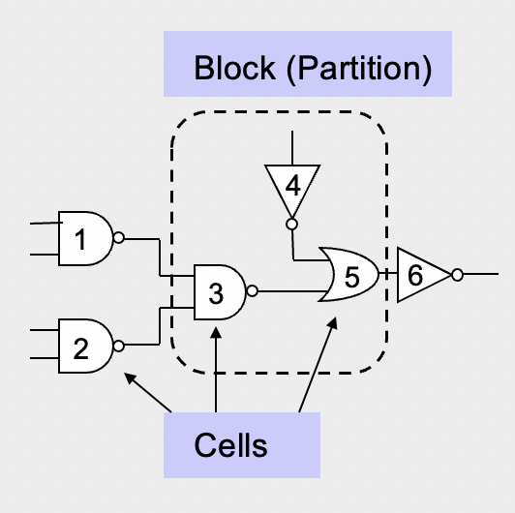
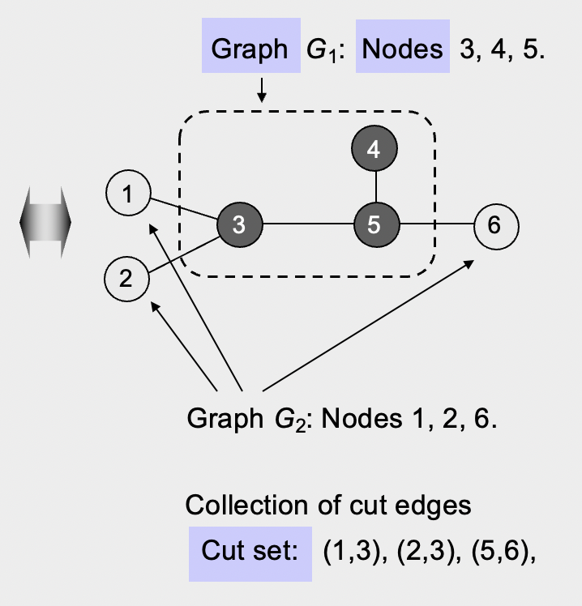
Partition Terminology

Slide 11
Optimization Goals
Given a graph G(V,E) with |V| nodes and |E| edges where each node v ⍷ V and each edge e ⍷ E.
Each node has area s(v) and each edge has cost or weight w(e).
The objective is to divide the graph G into k disjoint subgraphs such that all optimization goals are achieved and all original edge relations are respected.

Slide 12
Optimization Goals
In detail, what are the optimization goals?
Number of connections between partitions is minimized
Each partition meets all design constraints (size, number of external connections..)
Balance every partition as well as possible
How can we meet these goals?
Unfortunately, this problem is NP-hard
Efficient heuristics are developed in the 1970s and 1980s. They are high quality and in low-order polynomial time.

Slide 13
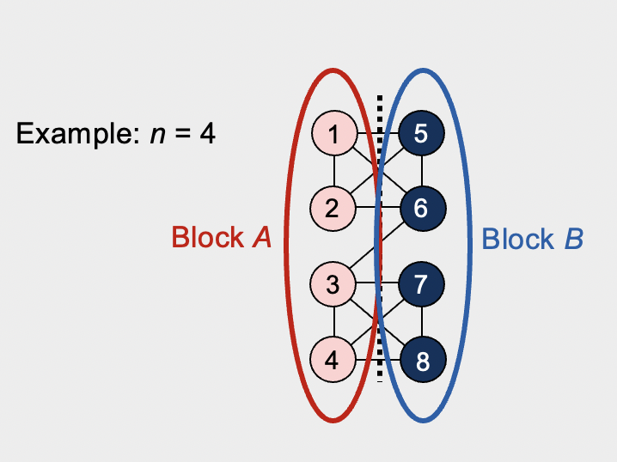
Kernighan Lin (KL Algorithm)
Given: A graph with 2n nodes where each node has the same weight.
Goal: A partition (division) of the graph into two disjoint subsets A and B with minimum cut cost and |A| = |B| = n.

Slide 14
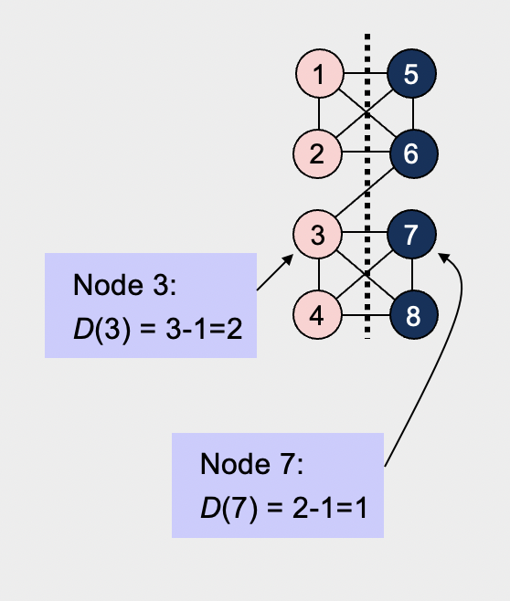
KL Algorithm (Terminology)
Cost D(v) of moving a node v
D(v) = |E_{c}(v)| – |E_{nc}(v)| ,
where
E_{c}(v) is the set of v’s incident edges that are cut by the cut line, and
E_{nc}(v) is the set of v’s incident edges that are not cut by the cut line.
High costs (D > 0) indicate that the node should move, while low costs (D < 0) indicate that the node should stay within the same partition.

Slide 15
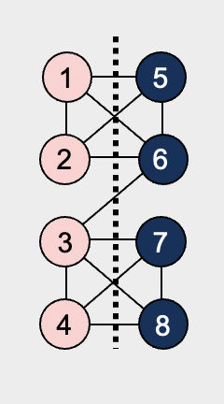
KL Algorithm (Terminology)
Gain of swapping a pair of nodes a und b
Δg = D(a) + D(b) - 2* c(a,b),
where
D(a), D(b) are the respective costs of nodes a, b
c(a,b) is the connection weight between a and b:
If an edge exists between a and b, then c(a,b) = edge weight (here 1),
otherwise, c(a,b) = 0.
The gain Δg indicates how useful the swap between two nodes will be
The larger Δg, the more the total cut cost will be reduced

Slide 16
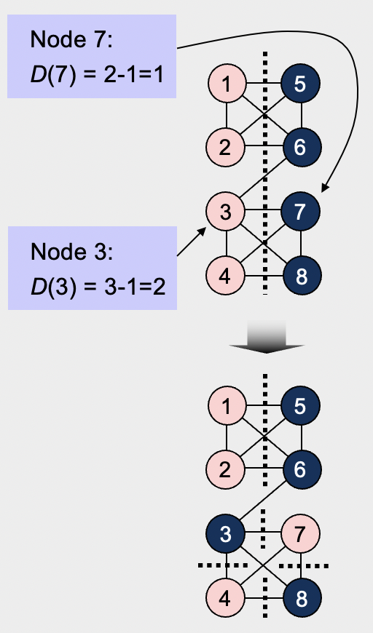
KL Algorithm (Terminology)
Gain of swapping a pair of nodes a und b
Δg = D(a) + D(b) - 2* c(a,b),
where
D(a), D(b) are the respective costs of nodes a, b
c(a,b) is the connection weight between a and b:
If an edge exists between a and b, then c(a,b) = edge weight (here 1),
otherwise, c(a,b) = 0.
Δg (3,7) = D(3) + D(7) - 2* c(a,b) = 2 + 1 – 2 = 1
=> Swapping nodes 3 and 7 would reduce the cut size by 1

Slide 17
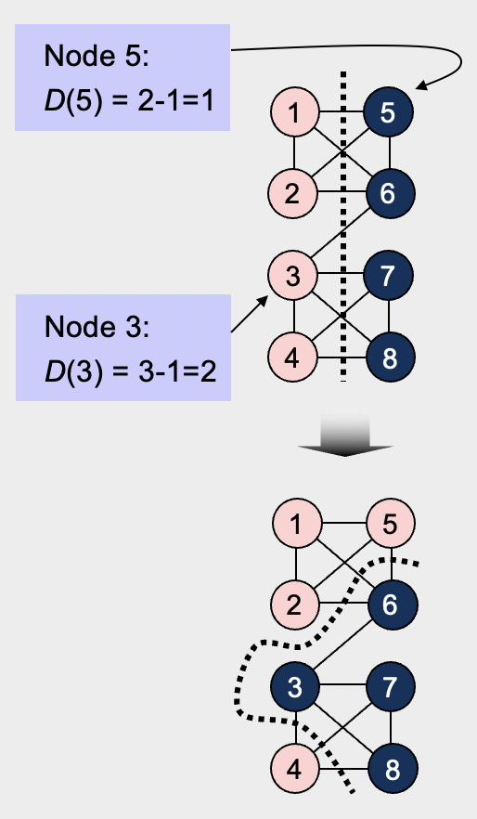
KL Algorithm (Terminology)
Gain of swapping a pair of nodes a und b
Δg = D(a) + D(b) - 2* c(a,b),
where
D(a), D(b) are the respective costs of nodes a, b
c(a,b) is the connection weight between a and b:
If an edge exists between a and b, then c(a,b) = edge weight (here 1),
otherwise, c(a,b) = 0.
Δg (3,5) = D(3) + D(5) - 2* c(a,b) = 2 + 1 – 0 = 3
=> Swapping nodes 3 and 5 would reduce the cut size by 3

Slide 18
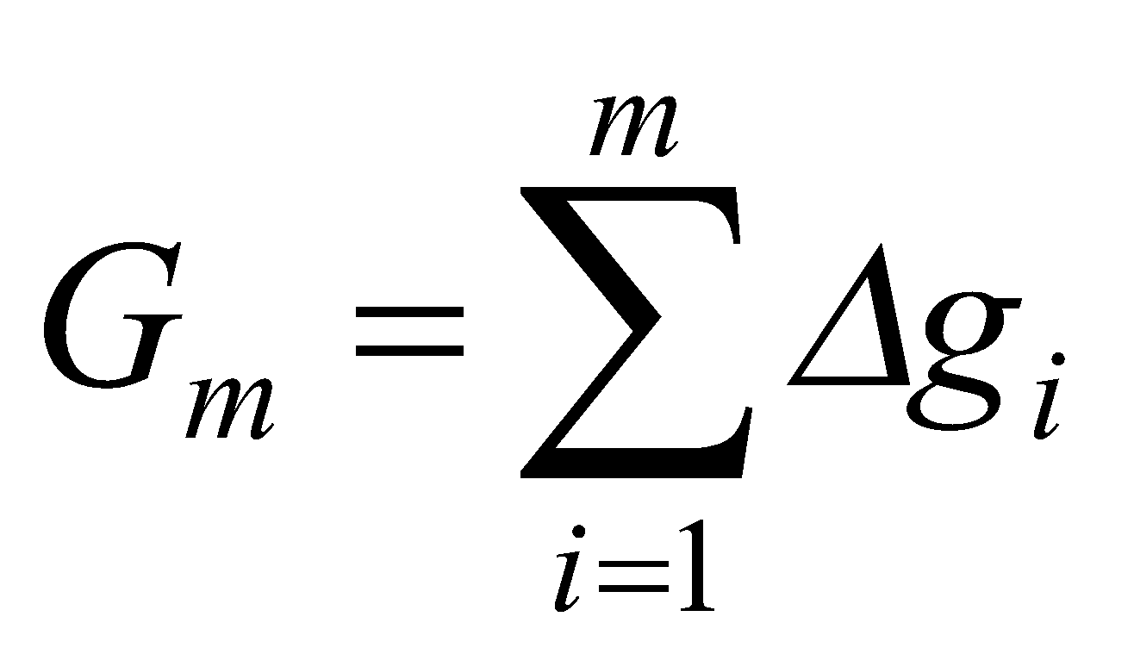
KL Algorithm (Terminology)
Gain of swapping a pair of nodes a und b
The goal is to find a pair of nodes a and b to exchange such that Δg is maximized and swap them.
Maximum positive gain G_{m} of a pass
The maximum positive gain G_{m} corresponds to the best prefix of m swaps within the swap sequence of a given pass.
These m swaps lead to the partition with the minimum cut cost encountered during the pass.
G_{m} is computed as the sum of Δg values over the first m swaps of the pass, with m chosen such that G_{m} is maximized.

Slide 19
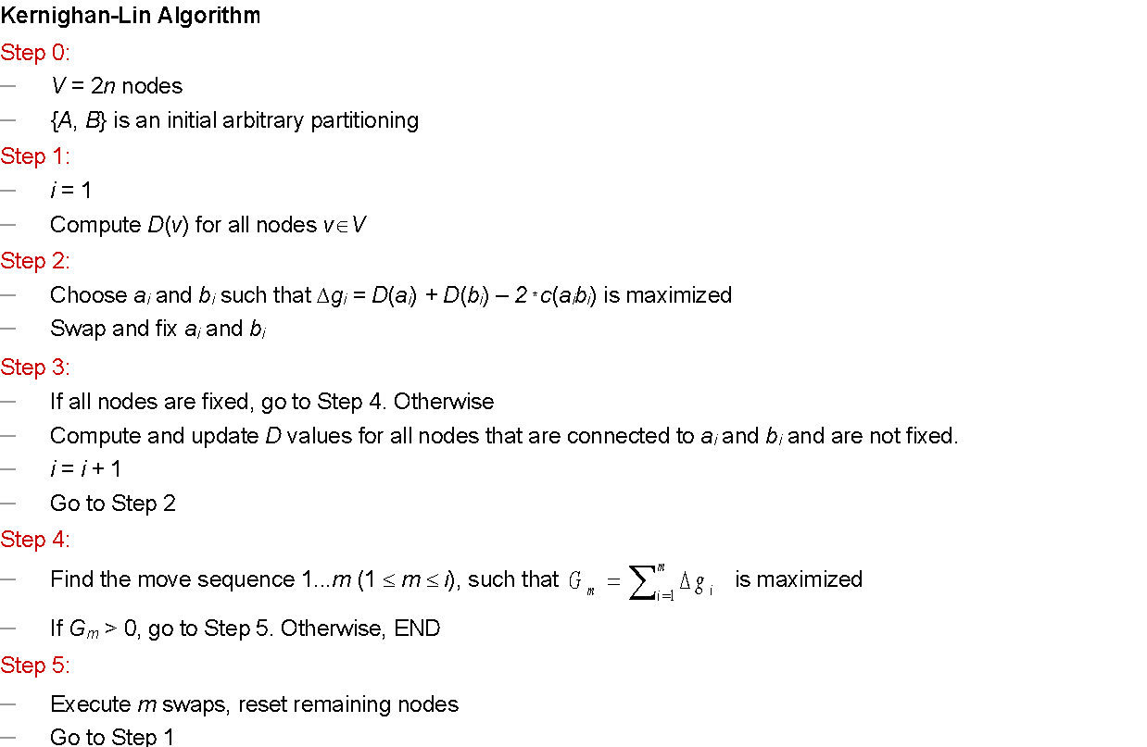
KL Algorithm (One-pass)

Slide 20
KL Algorithm (Example 1)
The graph (nodes a-f) can be optimally partitioned using the Kernighan-Lin algorithm. The dotted line represents the initial partitioning. Assume all the edges have the same weight.
What is the initial cut cost?
Perform the first pass of the algorithm. [Hint: For the “i”th iteration of the first pass, until all the nodes are swapped and fixed, do the following:
Compute/update the node costs of all unfixed nodes
Find the maximum gain of swapping a pair of nodes (Δg_{i})
Swap the pair and draw the updated graph]
Finish the first pass by computing the maximum positive gain, G_{m}. Suggest how many swaps should be actually executed in the first pass.
Should you perform subsequent passes of the algorithm? Why or why not?
a
d
b
e
c
f
Partition X
Partition Y

Slide 21
KL Algorithm (Example 1)
The graph (nodes a-f) can be optimally partitioned using the Kernighan-Lin algorithm. The dotted line represents the initial partitioning. Assume all the edges have the same weight.
What is the initial cut cost?
Ans: We can see that the initial partition line intersects 5 edges of the graph (shown in red). So the initial cut cost is 5.
a
d
b
e
c
f
Partition X
Partition Y

Slide 22
KL Algorithm (Example 1)
fix
The graph (nodes a-f) can be optimally partitioned using the Kernighan-Lin algorithm. The dotted line represents the initial partitioning. Assume all the edges have the same weight.
Perform the first pass of the algorithm. For the “i=1” iteration of the first pass:
Compute the node costs of all unfixed nodes
Ans: D(a) = 2 - 0 = 2; D(b) = 2 - 1 = 1; D(c) = 1 - 1 = 0;
D(d) = 1 - 1 = 0; D(e) = 2 - 1 = 1; D(f) = 2 - 0 = 2.
Find the maximum gain of swapping a pair of nodes (Δg_{i})
Ans: Δg₁(a, f) = 2 + 2 - 0 = 4.
Swap the pair and draw the updated graph
Ans: Swap nodes a & f, and fix them.
a
d
f
d
swap
b
e
b
e
c
f
c
a
Partition X
Partition Y
Partition X
Partition Y
Partition after completing the i=1st iteration
Initial partition

Slide 23
KL Algorithm (Example 1)
Perform the first pass of the algorithm. For the “i=2” iteration of the first pass:
Update the node costs of all unfixed nodes
Ans: D(a) = 2 - 0 = 2; D(b) = 1 - 2 =-1; D(c) = 0 - 2 =-2;
D(d) = 0 - 2 =-2; D(e) = 1 - 2 =-1; D(f) = 2 - 0 = 2.
Find the maximum gain of swapping a pair of nodes (Δg_{i})
Ans: Δg₂(b, d) = -1 -2 -0 = -3 or Δg₂(c, e) = -2 -1 -0 = -3
Swap the pair and draw the updated graph
Ans: Swap nodes b & d, and fix them or c & e, and fix them. [Both approaches are valid and will end in the same result.]
f
d
f
b
b
e
d
e
c
a
c
a
Partition X
Partition Y
Partition X
Partition Y
Partition after completing the i=1st iteration
Partition after completing the i=2nd iteration

Slide 24
KL Algorithm (Example 1)
Perform the first pass of the algorithm. For the “i=3” iteration of the first pass:
Update the node costs of all unfixed nodes
Ans: D(a) = 2 - 0 = 2; D(b) = 1 - 2 =-1; D(c) = 1 - 1 = 0;
D(d) = 1 - 1 = 0; D(e) = 1 - 2 =-1; D(f) = 2 - 0 = 2.
Find the maximum gain of swapping a pair of nodes (Δg_{i})
Ans: Δg₃(c, e) = 0 -1 - 0 = -1
Swap the pair and draw the updated graph
Ans: Swap nodes c & e, and fix them.
f
b
f
b
d
e
d
c
c
a
e
a
Partition X
Partition Y
Partition X
Partition Y
Partition after completing the i=2nd iteration
Partition after completing the i=3rd iteration

Slide 25
KL Algorithm (Example 1)
The first pass should end here.
f
d
f
b
f
b
b
e
d
e
d
c
c
a
c
a
e
a
Finish the first pass by computing the maximum positive gain, G_{m}. Suggest how many swaps should be actually executed in the first pass.
G₁ = Δg₁ + Δg₂ + Δg₃ = 4 - 4 + 0 = 4
G₂ = Δg₁ + Δg₂ + Δg₃ = 4 - 3 + 0 = 1
G₃ = Δg₁ + Δg₂ + Δg₃ = 4 - 3 +- 1 = 0
Hence, maximum positive gain is achieved for m = 1. Only the swap for Δg₁, or (a, f) should be executed.

Slide 26
KL Algorithm (Example 1)
The first pass should end here.
f
d
f
b
f
b
b
e
d
e
d
c
c
a
c
a
e
a
Should you perform subsequent passes of the algorithm? Why or why not?
Ans: Since G_{m} > 0, subsequent passes should be performed (until G_{m} ≤ 0).

Slide 27
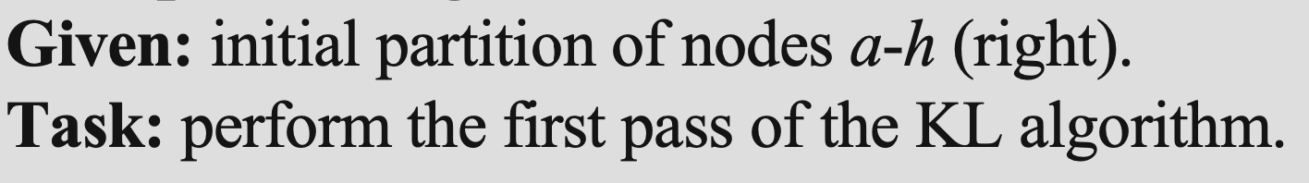
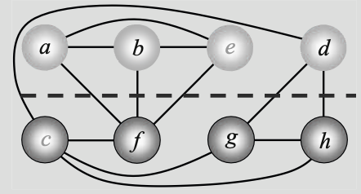
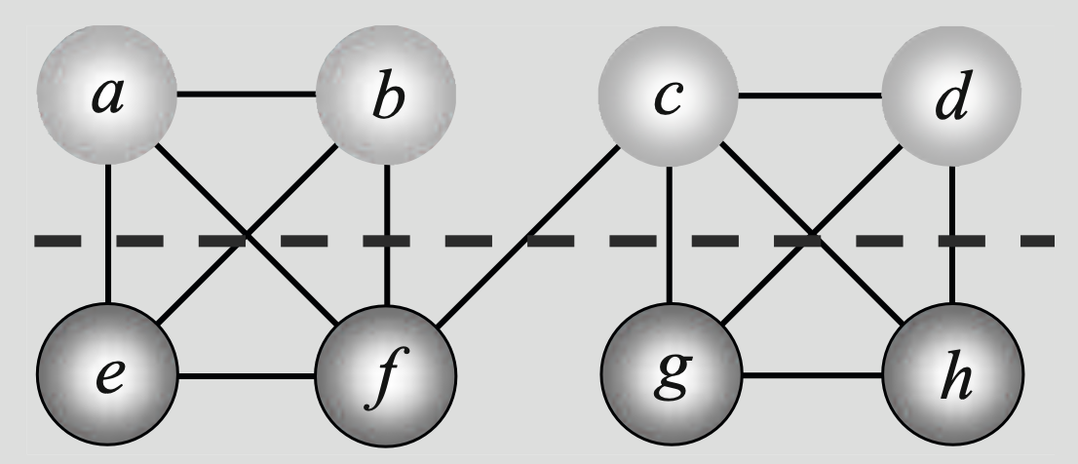
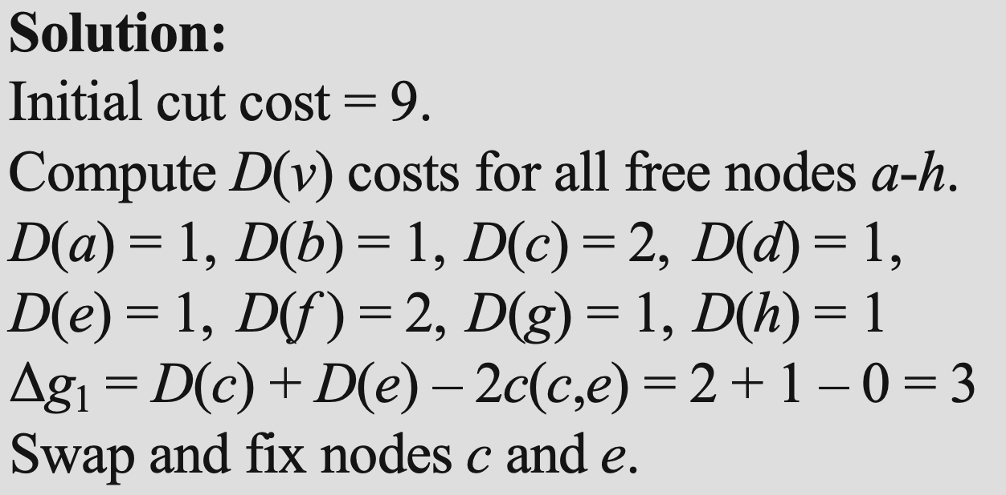
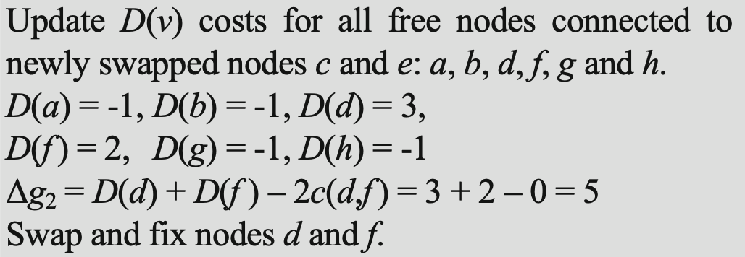
KL Algorithm (Example 2)

Slide 28
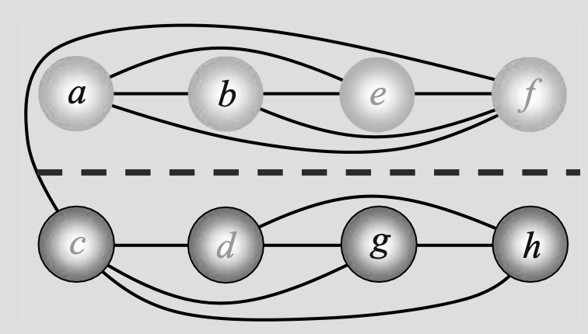
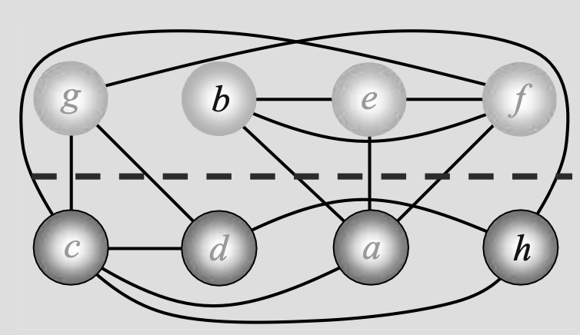
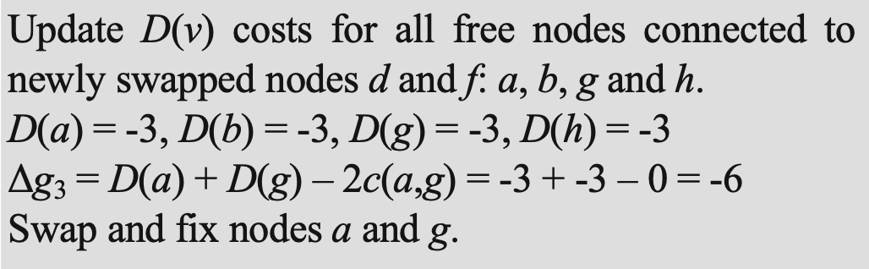
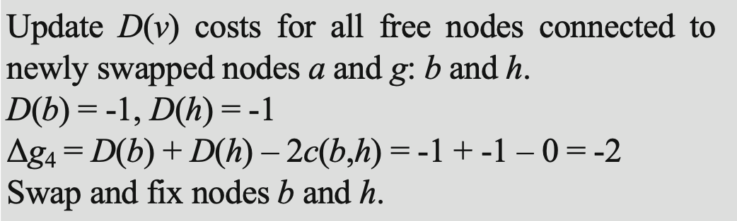
KL Algorithm (Example 2)

Slide 29
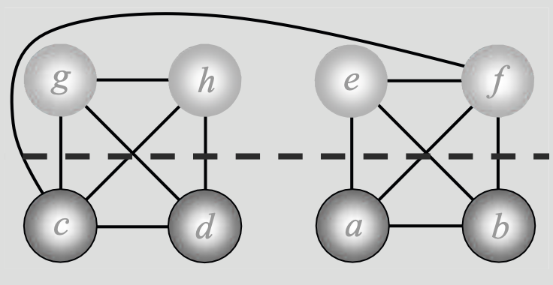
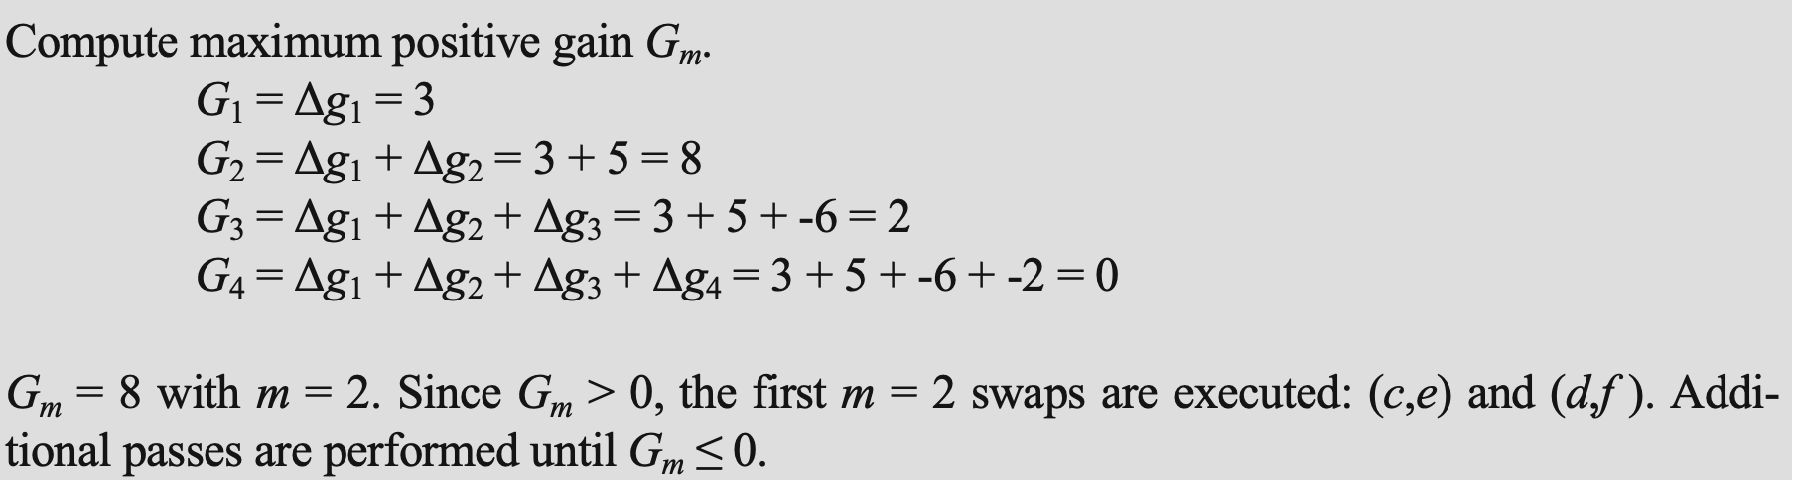
KL Algorithm (Example 2)

Slide 30
Thank you.

